Slide 1

Optimized Electricity Consumption Forecasting Using Machine Learning
Pranjal
Registration No: 12405076
Roll No: A18
Section – K24BB

Slide 2
Introduction
Electricity consumption forecasting is crucial for demand-side energy management and strategic planning.
Traditional statistical models often fail to capture nonlinear and complex patterns in usage data.
ML techniques provide advanced alternatives for accurate predictions.
This project compares regression-based ML models for effective energy demand forecasting.

Slide 3

Problem Statement & Objectives
Problem Statement:
Inaccurate forecasts cause inefficiencies in power distribution.
Need for reliable ML-based forecasting using consumption and weather data.
Objectives:
Develop and compare ML regression models.
Evaluate using MAE, MSE, RMSE, R².
Identify best-performing model for practical use.

Slide 4
Dataset Description
Source: Kaggle & Open Weather
Timeframe: Hourly electricity consumption records
Key Features:
Datetime: date, hour
Weather: temperature, humidity, wind speed, etc.
Target: average electricity load per hour

Slide 5
Methodology – Data Collection & Preprocessing
Data Collection:
Hourly electricity & weather data
Preprocessing:
Parsed datetime to hour, day, month
Dropped redundant columns
Normalized features using StandardScaler

Slide 6

Methodology – Feature Engineering
Added time-based features:
Hour of day, day of week, month
Created lag features for time-aware models
Enhances temporal learning especially for XGBoost

Slide 7
Methodology – Modeling & Evaluation
Models Trained:
Linear, Ridge, Lasso, Decision Tree, Random Forest, XGBoost, Time-aware XGBoost
Evaluation Metrics:
MAE, MSE, RMSE, R²
Model Selection:
XGBoost chosen based on superior performance

Slide 8
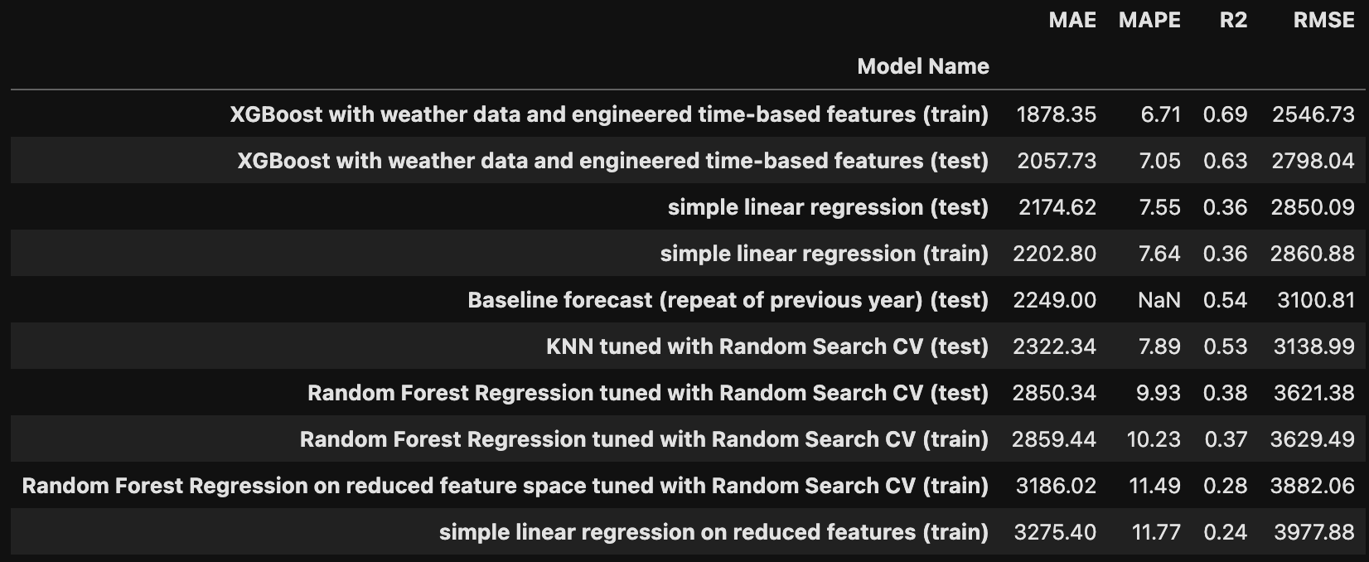
Model Performance Comparison
Best Performer: XGBoost
Underperformers: KNN, Linear Regression

Slide 9
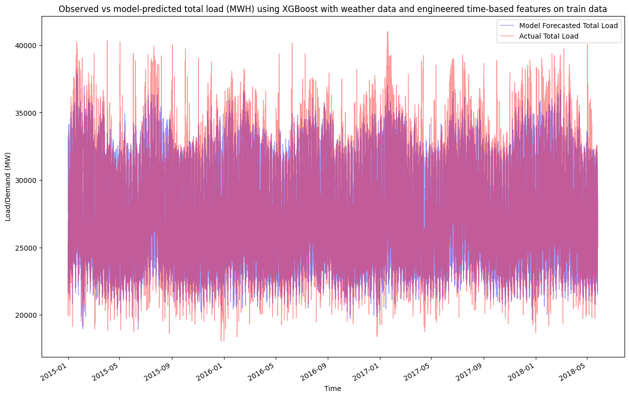
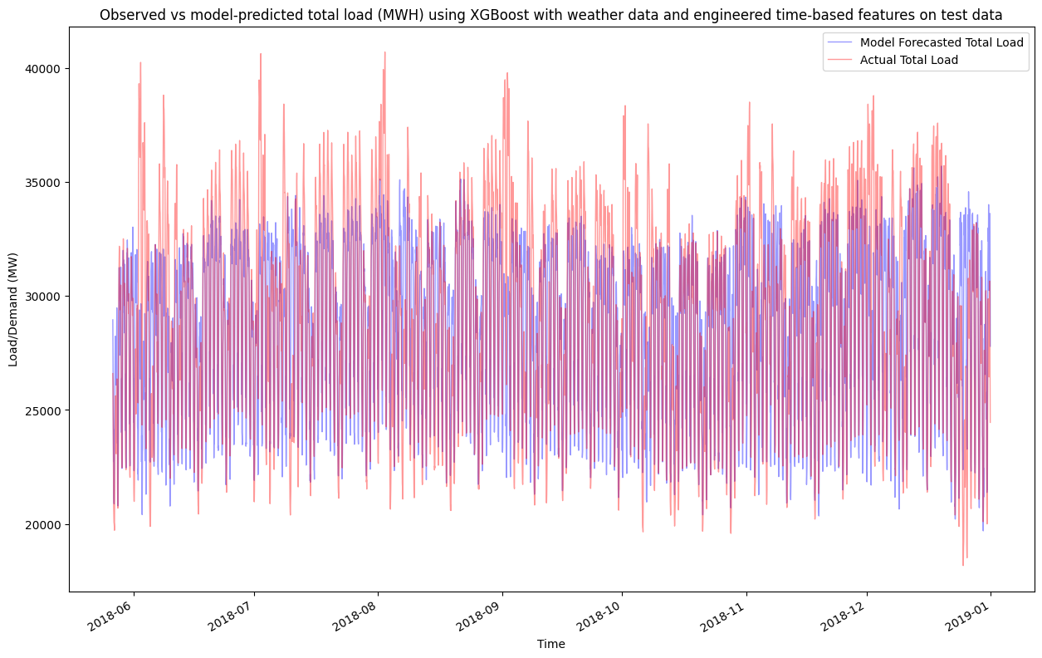
Forecast Visualization
Observed vs Predicted (XGBoost) → Very close tracking

Slide 10
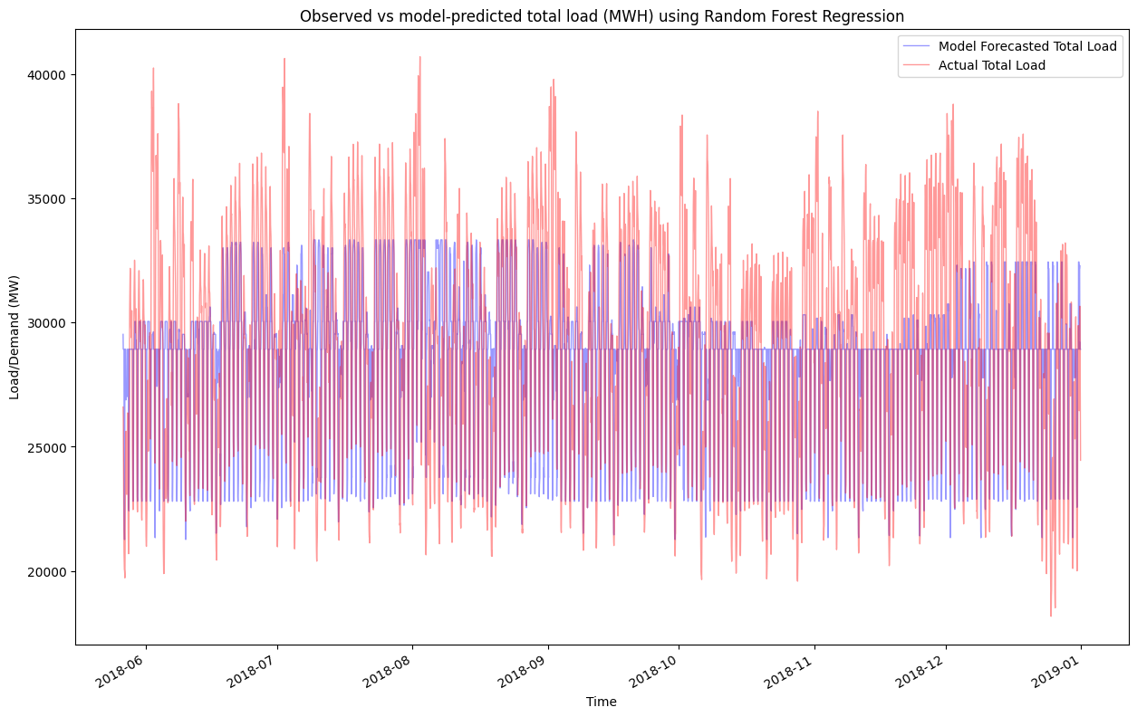
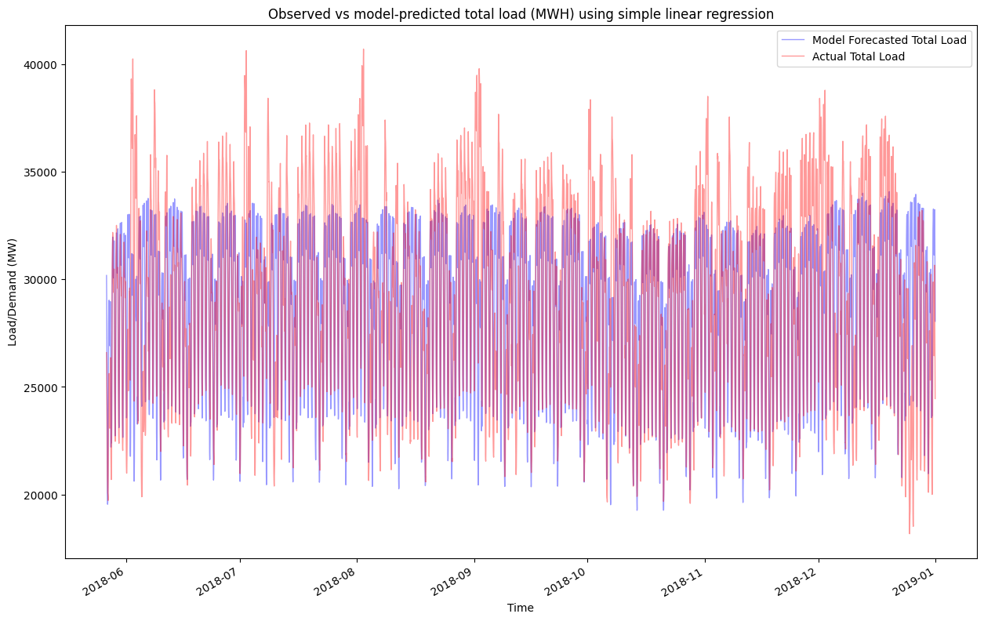
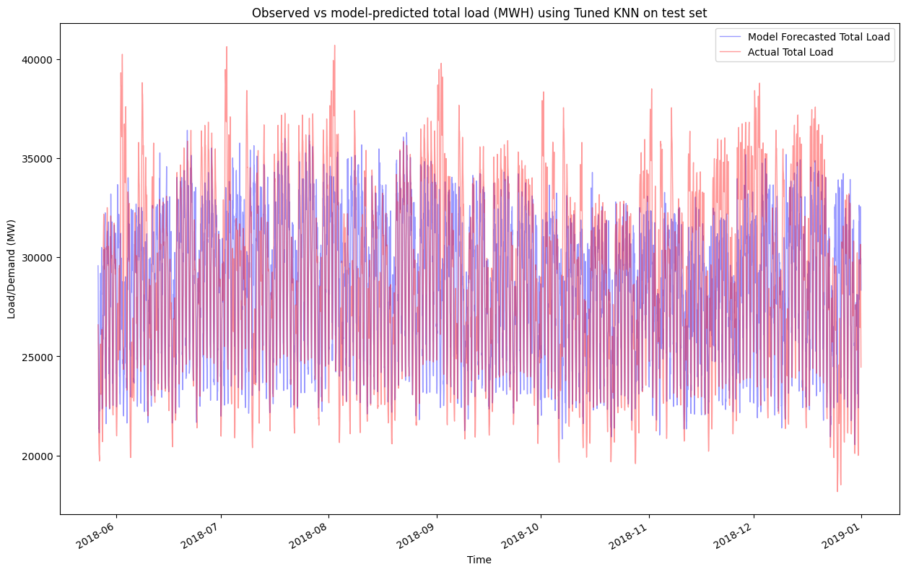
Forecast Visualization
Comparison of all models → XGBoost shows least deviation

Slide 11
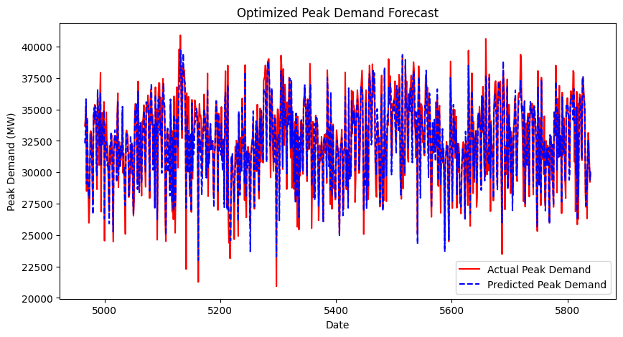
Forecast Visualization
Time Series (peak demand) → XGBoost captures peaks well

Slide 12
Insights & Discussion
XGBoost Benefits:
Captures non-linear interactions
Regularization avoids overfitting
Challenges:
Linear models too simplistic
KNN affected by high dimensionality
Temporal Features:
Lag, hour, day improved short-term accuracy

Slide 13
Future Work & Enhancements
Add external data: holidays, pricing, socio-economic factors
Try LSTM, GRU for deep temporal modeling
Explore real-time forecasting with online learning
Perform hyperparameter tuning and cross-validation

Slide 14

Conclusion
XGBoost outperformed other models in forecasting accuracy
Time-aware features enhanced short-term predictions
Linear and KNN models were not effective
Applications:
Grid planning
Cost optimization
Real-time decision-making

Slide 15

Thank you

